Slide 1

BESTIL LIBRARY MANAGEMENT SYSTEM
NAME: Baghyaa V S
BATCH: 2023-10141
CENTRE: CHENNAI
GUIDED BY: PRAISY J

Slide 2

INTRODUCTION
Library Management System is discipline of planning, organizing and managing the library task.
It is about displaying books in the library, issuing books to the students and getting books from students who lend it from library.
In this mini project, Implementation of Library Management System in a simple way using java programming language.

Slide 3



HARDWARE AND SOFTWARE
Hardware requirements:
Processor: Intel®Celeron® CPU 1007U@1.50GHz
RAM: 4GB
System Type: 64-bit Operating System, x-64 based processor
Software requirements:
IDE: Eclipse
Programming language: JavaSE-17

Slide 4

MODULES USED
Classes ---- books, StudentData, bookRec, Students.
Parameterized constructor --- StudentData, books
Switch case
Encapsulation --- books, StudentData
Loop statements --- for, while and do-while
Control statements --- if-else

Slide 5

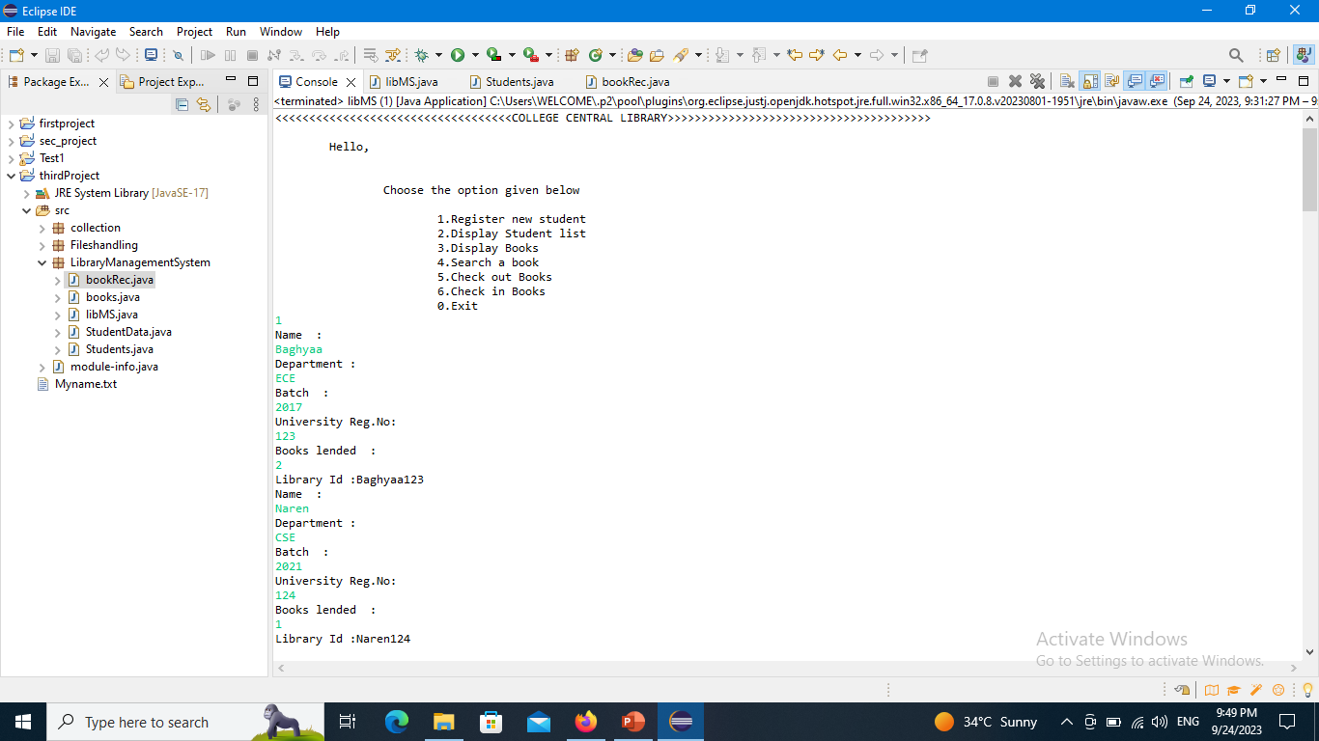
OUTPUT
1. REGISTER NEW STUDENTS

Slide 6

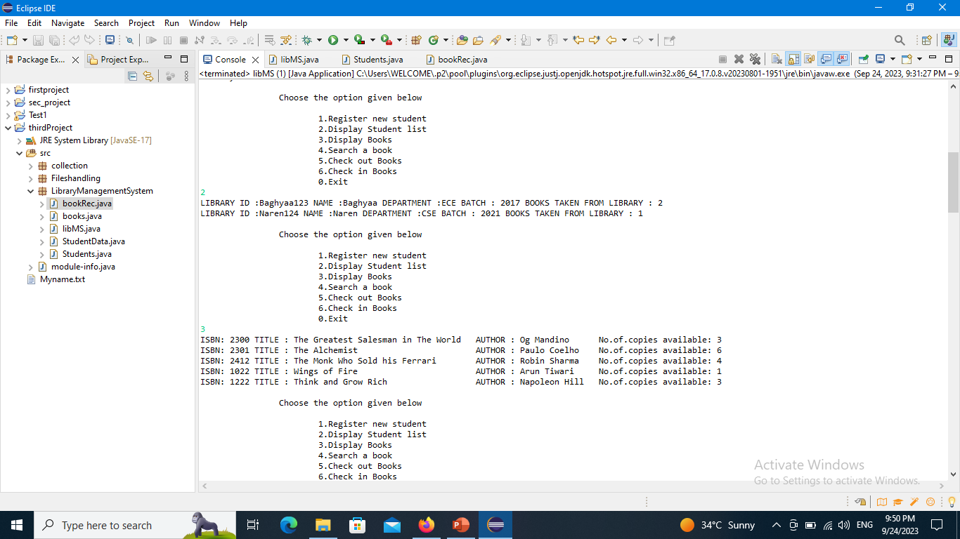
2. DISPLAY STUDENT LIST AND BOOKS IN THE LIBRARY

Slide 7

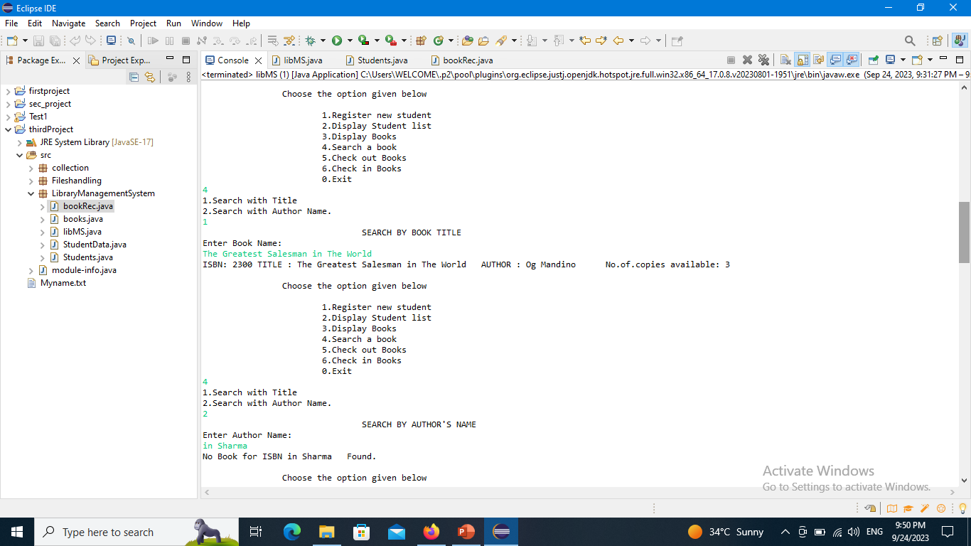
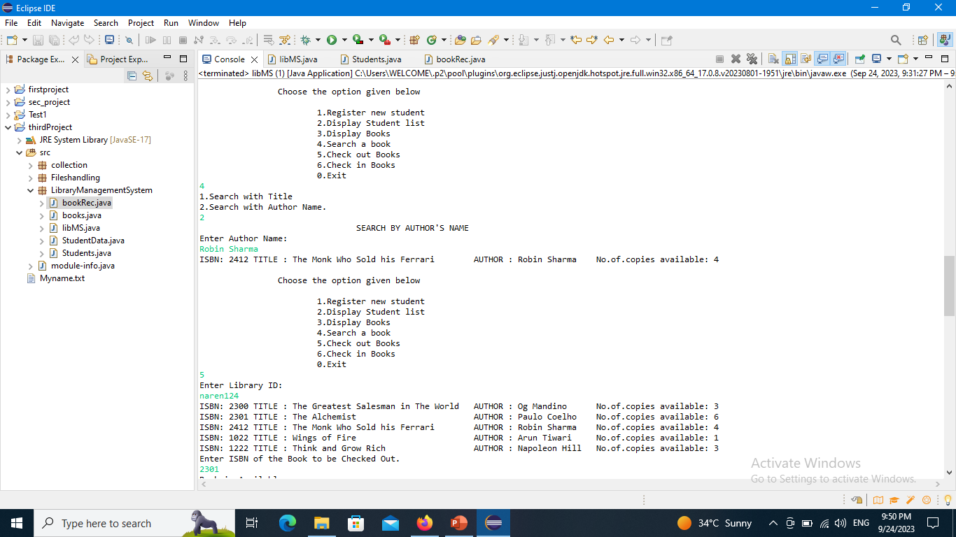
3. SEARCH A BOOK

Slide 8

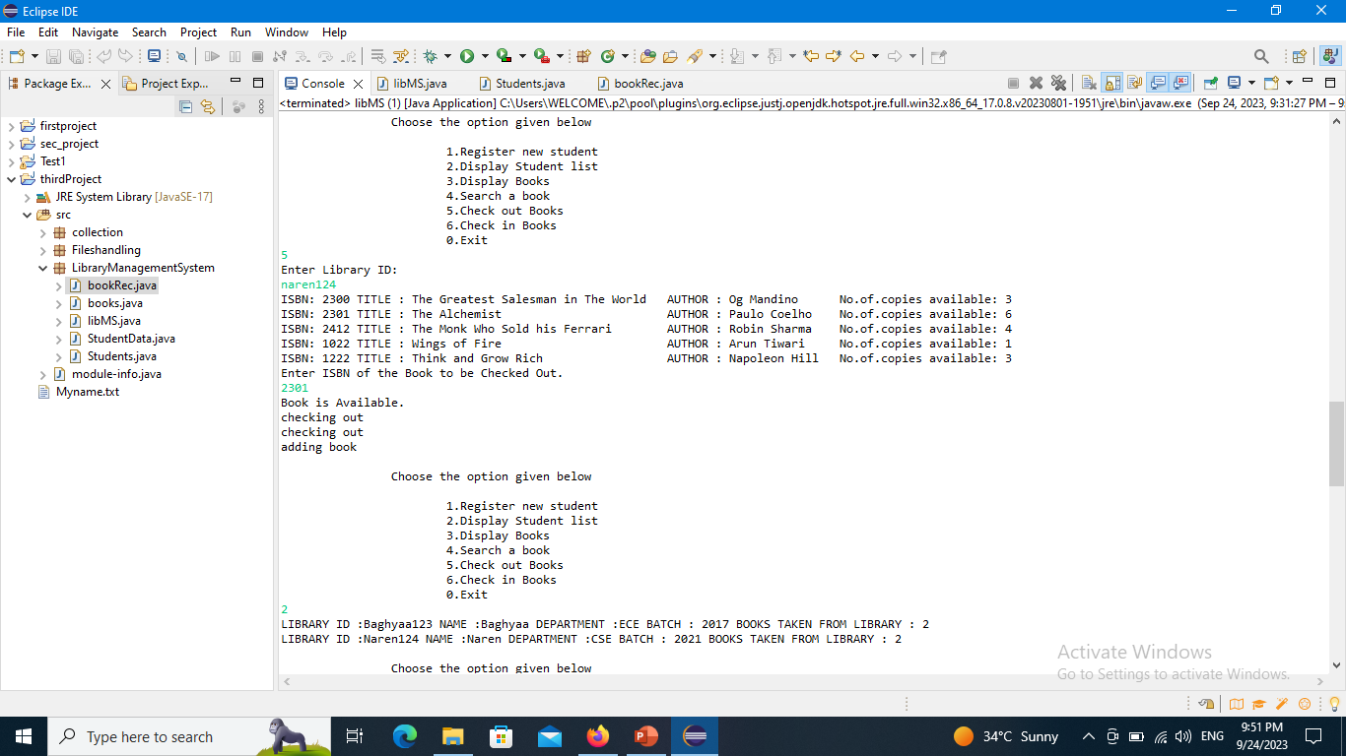
4. LENDING BOOK TO THE STUDENT

Slide 9

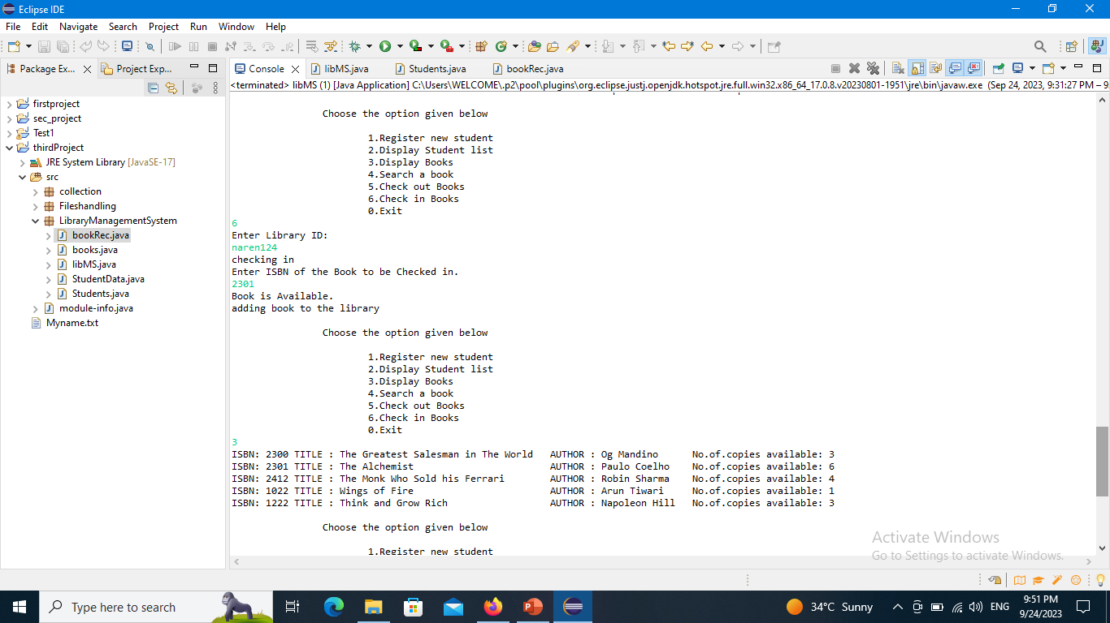
5. RETURNING BOOK TO THE LIBRARY

Slide 10

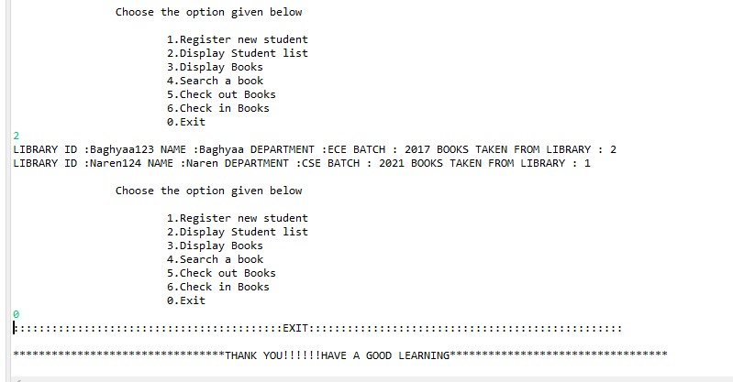
6.EXIT FROM THE PROGRAM

Slide 11


